Slide 1
Developmental representations

Slide 2
Simple fixed-length encodings
Bit string/ character string
  01001001001011111100
  Methinksiusdfhdsf7w4ruinjkfvbh
  ACTGACACACGTAGCTAC
In ‘methinks’ the fitness of an individual is a direct function of the characters in the genotype: the more that match with the target the better
In natural organisms the mapping from genotype to fitness is mediated by the phenotype and the complex process of development

Slide 3
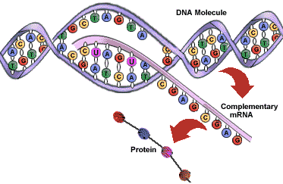
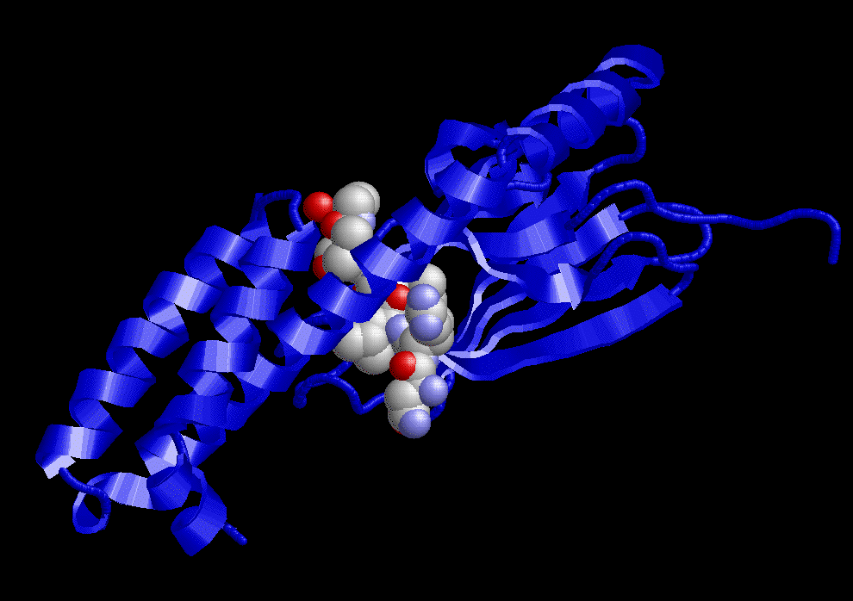
Development 1
DNA in fertilised zygote is transcribed and translated into amino-acid sequence
Amino-acid sequences fold into proteins
Proteins (and RNA) control everything that goes on in the cell, its shape and function → cell division and differentiation

Slide 4
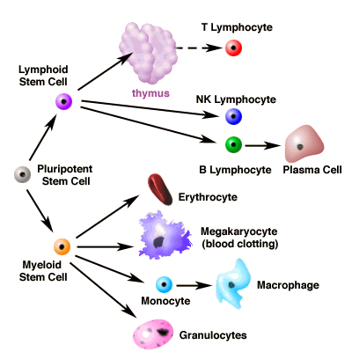
Development 2: cell differentiation
A little bit of the cell differentiation in immune system

Slide 5
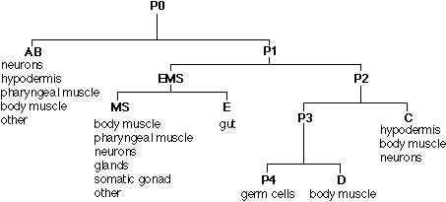
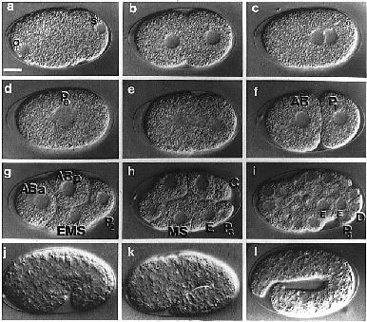
Development 3: morphogenesis
C.elegans (a little worm)

Slide 6
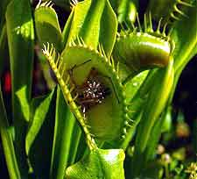
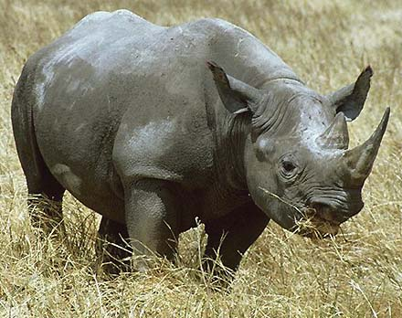
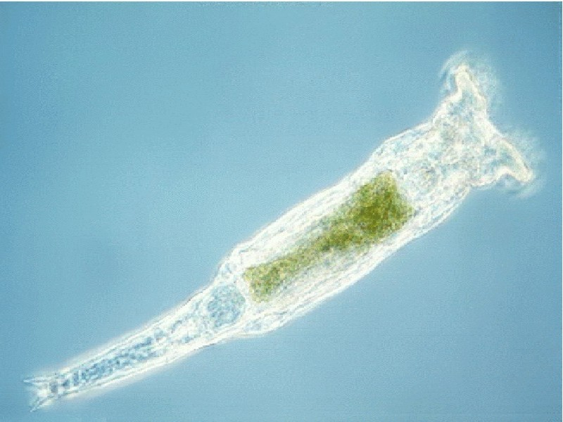
Development 4: phenotype → fitness
Phenotypic features (aka character traits) – morphology, behaviour… e.g.
  Size
  Shape
  number of wisker-things
  having the enzymes to digest flies
And these phenotypic features impact fitness via
  Getting food
  Metabolic functions
  Reproduction
  Etc, etc.

Slide 7
The ‘genotype → phenotype’ mapping
How does a phenotypic feature (aka ‘character trait’) like size, shape, relate to the genes?
  Which genes were responsible for it?
  What sequence should the genes have to produce that feature?
Suffice to say: It’s a very complex mapping from genotype to phenotype. Including:
  Epistasis: effect of a mutation depends on genetic background
  Pleiotropy: one gene influences many traits
  Redundancy: many genotypes map to a particular phenotype
  Neutrality: some mutations on some backgrounds have no fitness effect
All these complexities affect the evolvability of systems

Slide 8
What properties of this mapping might be important for evolution of complexity?
Connectivity (selective accessibility) of phenotypes
  Out of the set of beetle-like things functionally similar beetles genetically close together. (see bias)
Bias
  Beetles with horns very likely/over-represented
  (what’s more: these biases are evolved)
Modularity 1: Functional decomposition
  Shape of myoglobin protein largely controlled by one gene
  Function of heart largely independent of ears
Modularity 2: Repetition/self similarity
  Parts of the morphology are repeated (e.g. body segments, legs, tissues) and one genetic change can modify them all at once

Slide 9
Types of representation
‘Structured genotypes’
  Artificial neural networks
  Finite state machines
  are the genotypes really different from strings?
  Variable-size parameter sets
  Relative indexing
Tree encodings (Genetic programming)
Grammar-based encodings
  L-systems: re-write rules → structured strings
Turning strings into structure
  Cellular encoding – Gruau RNNs
  Turtle graphics - genobots

Slide 10
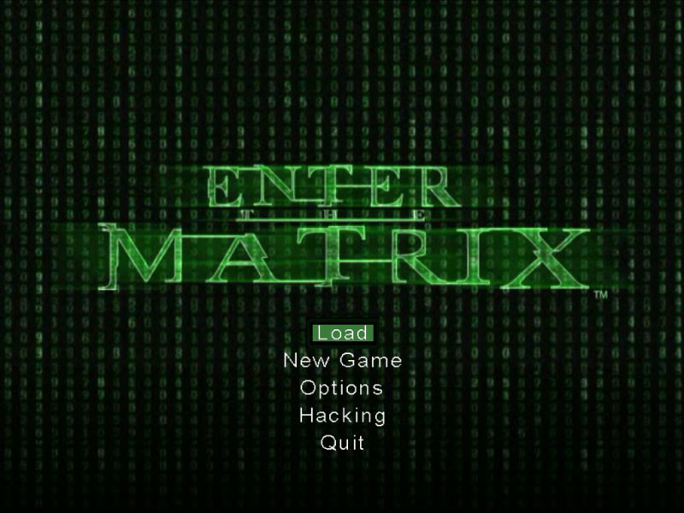
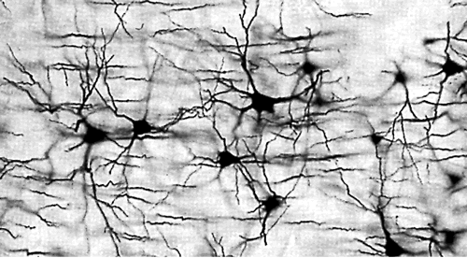
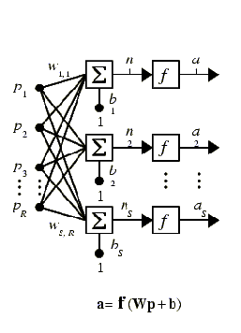
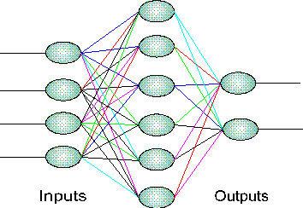
‘Structured genotypes’
Artificial neural networks (ANNs)
 | out1 | out2 | out3
in1 | 0.230 | 0.089 | 1.679
in2 | -1.500 | 3.320 | 3.211
in3 | 0.001 | -3.450 | 3.444
in4 | -3.220 | -2.000 | -0.002
bias | 0.000 | -2.033 | -1.101

Slide 11
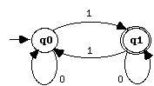
Structured representations 2
Finite state machines (FSMs)
(accept or) generate a string in a ‘language’
 | Q0 | Q1
Q0 | 0 | 1
Q1* | 1 | 0
e.g. strings with an odd number of 1s
00010100100100111
0010100111101
1010101000011110000001

Slide 12
Structures vs strings
Are the genotypes really different from strings?
We could represent these matrices as strings
How should variation operators manipulate this?
E.g. mutation randomises a node in the network – all its outgoing weights, or just one weight
E.g. should crossover be allowed to fall in the middle of a node?
Row 1
Row 2
Row 3
Row 4
1.2
0.3
3.1
-2.0
…

Slide 13
Variable-size parameter sets
If we want to have the number of neurons in the network increase, then maybe we can just introduce a variation operator that adds a new row (input node) or column (output node)
Problems…
If it’s a recurrent network, where any node can be connected to any other node then a new node creates a new column and a new row
How do you crossover two individuals of different sizes?
If the network is sparsely connected, we needn’t use a representation that grows as N²

Slide 14
Relative vs absolute connections
node
node
node
+2 | 0.3 | +3 | -2.0 | +5 | -0.2 | +3 | 0.5 | -1 | 1.2 | -2 | 0.4
node2
node1
node3
node4

Slide 15
Trees
Some applications suit a tree-based representation of individuals
Famously, ‘genetic programming’, John Koza
LISP s-expressions are functions (number of input variables, one output variable)
E.g. f (x, y)= (x +6) * (y * (y-1))
*
+
*
-
x
6
y
y
1

Slide 16
Crossover with trees
Individual 1
Individual 2
*
-
+
+
*
+
*
/
-
-
x
6
y
x
x
x
y
1
y
5
*
-
+
/
*
+
*
-
-
x
6
x
x
y
x
y
5
y
1
Trees used for other things too

Slide 17
Grammar based representations
Iterated application of re-write rules
Lindenmayer-systems (“L-systems”)
  Simultaneous re-write of all non-terminal characters
E.g. Context free L-system
  S→ABA
  A→aBa
  B→AbA
S→ABA→ aBaAbAaBa→ aAbAaaBabaBaaAbAa → aaBabaBaaaAbAabaAbAaaaBabaBaa
When we’ve done enough iterations, remove remaining nontermials → aaabaaaabababaaaabaaa

Slide 18
Turning strings into structure
Cellular encoding
Turtle graphics - genobots

Slide 19
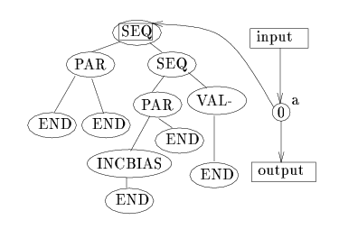
‘Cellular encoding’
For artificial neural networks, ANNs
  Frederic Gruau
Tree represents structured modifications (divide, cut, value, end) to a neural network, that starts off with just one internal node

Slide 20
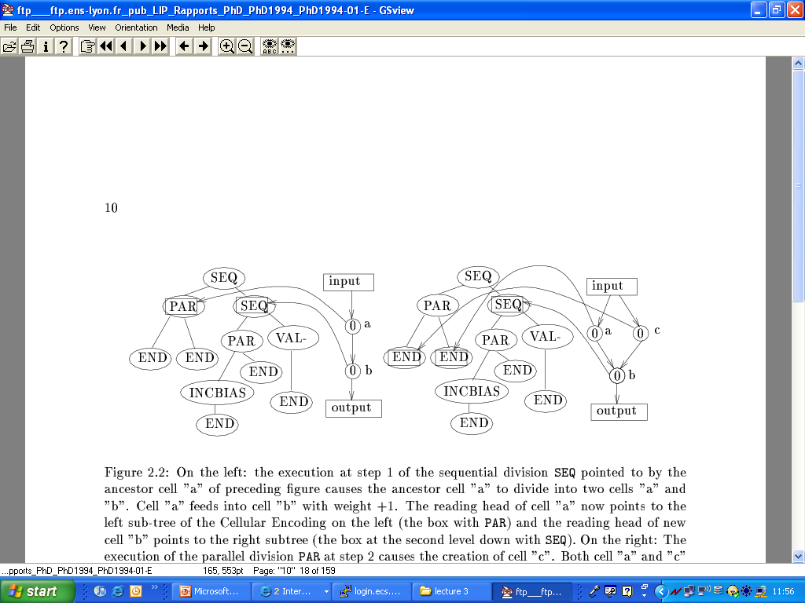
Cellular encoding
Sequential divide, daughter cells take pointers to subtrees
parallel divide

Slide 21
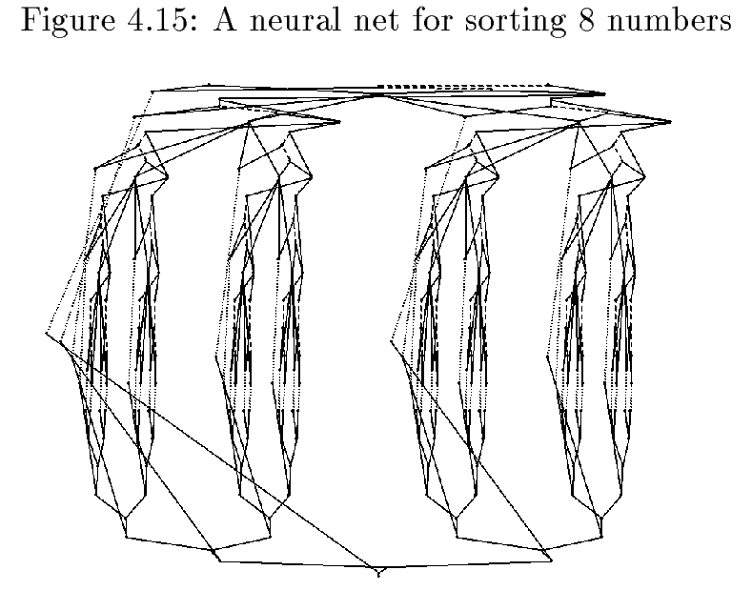
Cellular encoding…
Cellular encoding creates a grammar-like representation of ANNs
And the grammar is encoded in a tree
Crossing over trees → crossing networks
Exhibits properties of repeated modularity/ self-similarity
Can be exploited for tasks that have self-similarity (e.g. sorting)

Slide 22
Turtle graphics:
Forward 10
Right 90
Forward 10
Right 90
Forward 10
Turtles instructions from L-systems
  S → f10,r1,S
  → f10,r1, f10,r1,S → f10,r1, f10,r1, f10,r1,S

Slide 23
Turtle graphics: w. branching
f10,[r10, f20],l10,f20

Slide 24
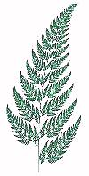
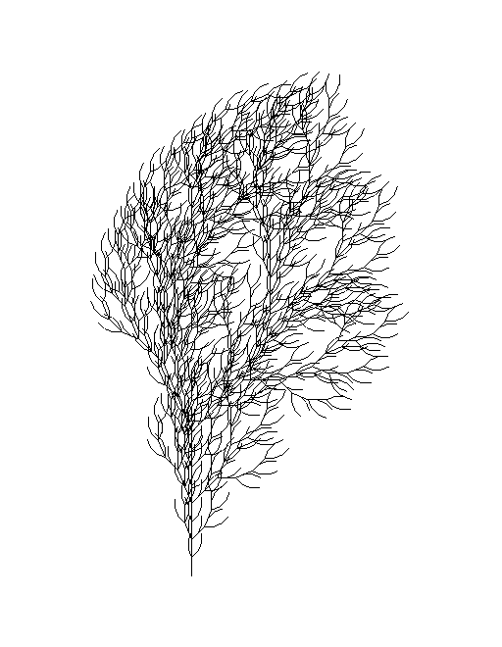
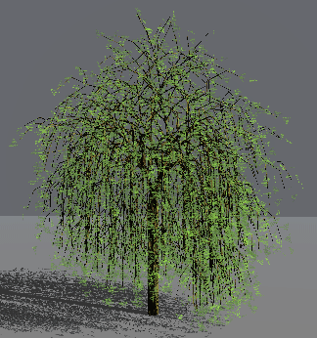
Turtle graphics + L-systems
L-system grammar, write instructions for turtle

Slide 25
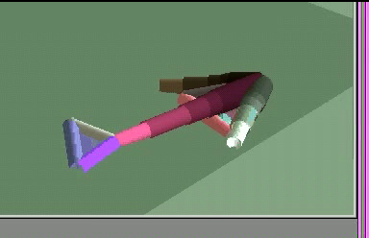
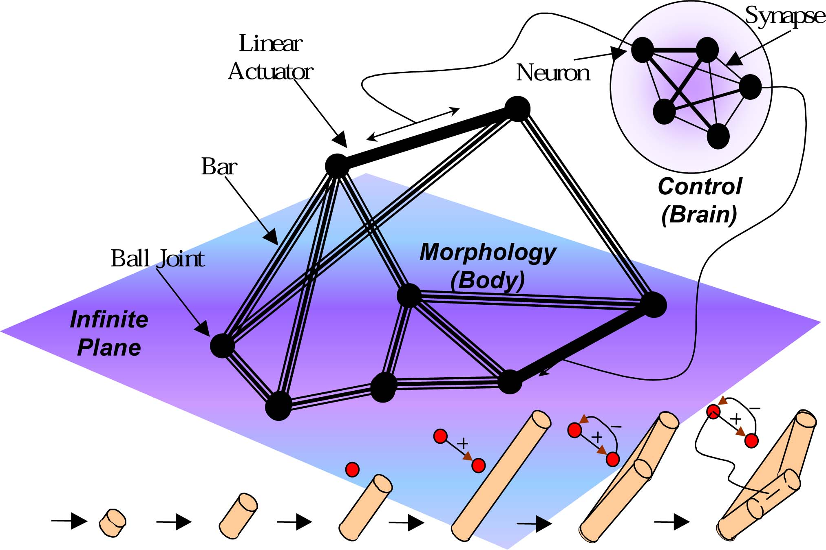
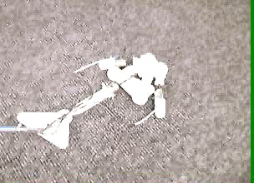
Variable size morphology and control: Golems
Genetically Organized Lifelike Electro Mechanics
Hod Lipson

Slide 26
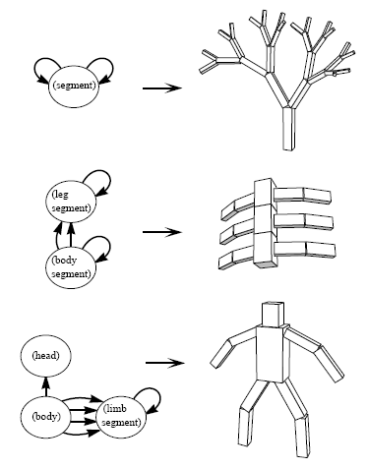
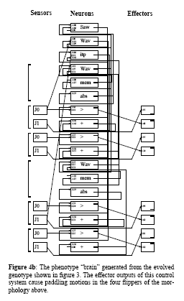
Plus tree-based FSMs define structure: Creatures
Karl Sims
FSM (represented as trees)
Code for body segments
And ANN controllers at the joints

Slide 27
Similar plus L-system morphology: genobots
Greg Hornby
Evolved L-system structure w. embedded oscillator behaviours
In simulation
In physicality

Slide 28
Summary
In ‘methinks’ example and other optimisation applications of EAs, a direct encoding of genotype=phenotype may be appropriate
But for the evolution of more complex systems this may be insufficient
In natural organisms the genotype↔phenotype mapping is provided by a developmental process with interesting properties like modularity, self-similarity, other biases

Slide 29
Artificial developmental representations
Various, more sophisticated, representations have been used in artificial evolution
  Structured representations
  Variable length representations
  Trees
  Grammars: FSM, L-systems
Which have been used to encode
  Neural networks
  FSMs
  S-expressions
  Turtle graphics
  Creatures

